Slide 1
SMART PLANTATION

Slide 2
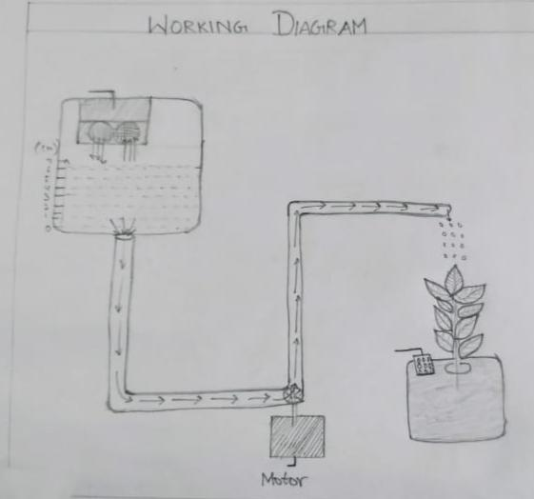
About the Project
Solution for Over Flow of Water
Less time consuming
Drip Irrigation System
Smart Plantation promotes Greenary to our environment.
Helps to grow flowers and vegetables in our home.

Slide 3
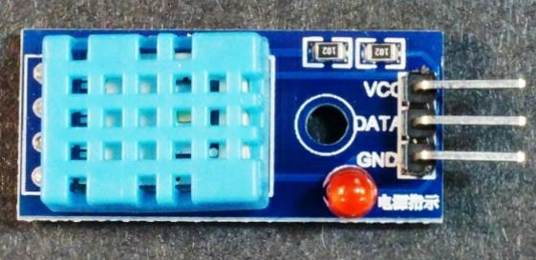
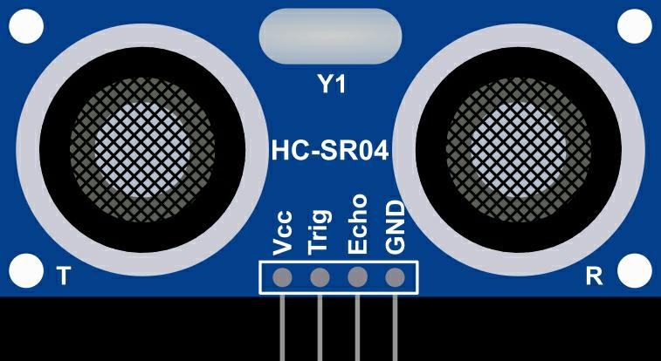
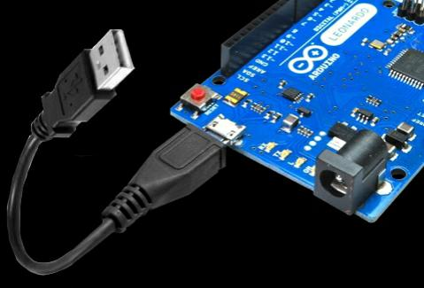
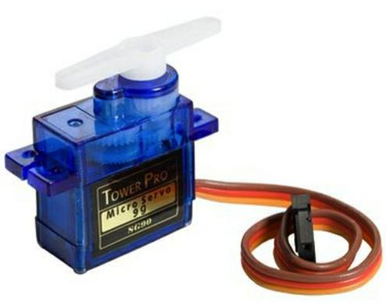
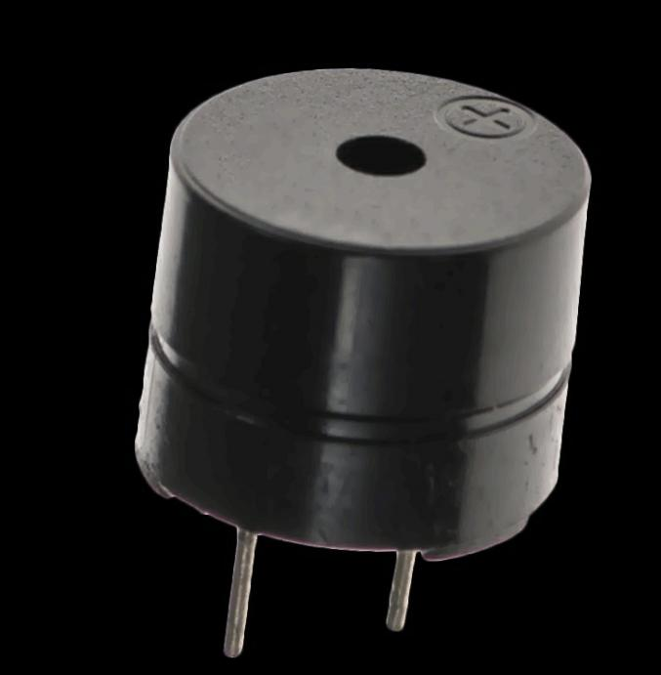
Components
DHT11 Sensor
Ultrasonic Sensor
ARDUINO
Servo Motor
Buzzer

Slide 4
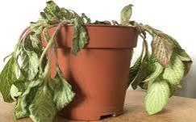
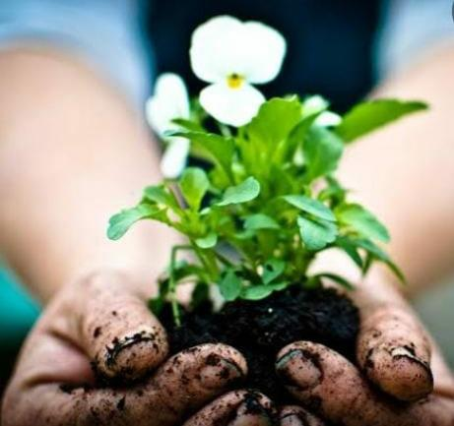
Application
Busy lifestyle of people.
Scope of Smart Plantation in human life.
Smart Plantation is the better way to grow plants.
With regards
IOT – 01

Slide 5
